Slide 1
Networking in GNU/Linux
#fsmkcamp15
mail@sarathms.me

Slide 2
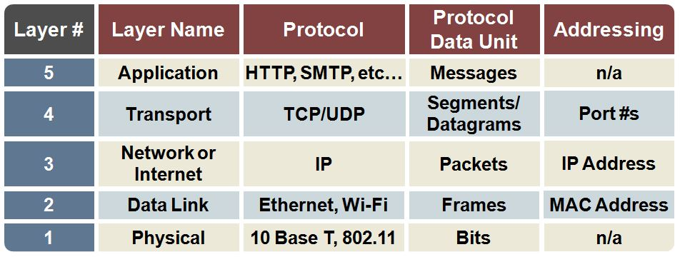
TCP/IP Stack

Slide 3
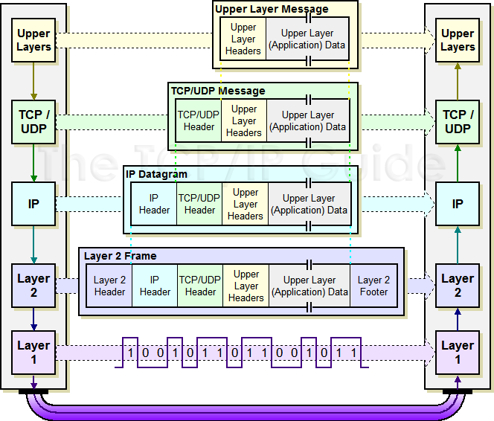
Data Flow
#Netception

Slide 4
Terminology
host any computer / server
hostname human-readable name of a host
protocol a defined set of rules for hosts to talk to each other
application a software tool (e.g browser, Xchat, ssh)
packet a well-defined ‘subset’ of data being communicated
NetNeutrality you should fight for this! (Issued in Public Interest)

Slide 5
IP Addressing
$ ifconfig
IP Address - 128.35.200.56
Subnet Mask - 255.255.0.0
Gateway - 128.35.0.1

Slide 6
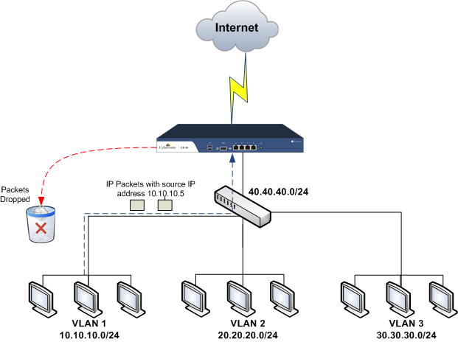

Slide 7

Domain Name System (DNS)
/etc/hosts
/etc/resolv.conf
Notes:
https://www.youtube.com/watch?v=BCjUbpIzRs8

Slide 8
$ ping
Its a diagnostics tool
Not as in “Hey! ‘ping’ me your number”
Notes:
-i -c -R

Slide 9
$ telnet
Purpose: diagnostics, remote access
Connects to anything
Notes:
Connect to a webserver
Listen with netcat

Slide 10
$ netstat
Live network status
Statistics
Notes:
Show various applications listening
-n
-l
-t
-p
-s

Slide 11
$ traceroute
track connections
Notes:
Mention mtr

Slide 12
$ nmap
Explore the network / Internet
Port scanning
Notes:
Simple localhost scan
scanning for specific ports
-p

Slide 13
$ tcpdump
Capture network traffic
Notes:
tcpdump icmp
tcpdump port 80
tcpdump -n

Slide 14
Wireshark
Packet Analyzer
Notes:
Login example
Web page example
DNS
TCP Handshake

